Slide 1
CT Location
Siddhanth Shekhar, Amir Kharazmi, Meghana Padmanabhan, Parmoon Bayat Sarmadi, Hajra Begum
Wednesday, April 1st, 2020

Slide 2
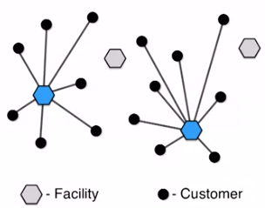
Facility Location
PROBLEM DESCRIPTION
The study of facility location problems (FLP), also known as location analysis, is a branch of operations research and computational geometry concerned with the optimal placement of facilities to minimize costs.
To solve FLPs, we can use Integer Programming; a decision making method that uses integers.
Notes:
Several mathematical methods can be used to solve decision-making problems. One of which is integer programming. This method uses linear programming and makes decision variables into integers.

Slide 3
PROBLEM DESCRIPTION
Resource distribution for CT scans is uneven across census tracts in Tolana Province. Regional health authority (RHA) for Tolana Province aims to improve CT access.
Tolana Province: 959 census tracts, about 2,000-4,000 inhabitants each
RHA hopes to install new CT machines at hospitals for 90% of the population to be within 120 minutes of a CT, through to 2029.
Notes:
Several mathematical methods can be used to solve decision-making problems. One of which is integer programming. This method uses linear programming and makes decision variables into integers.

Slide 4
OBJECTIVE
Build an Excel-based DSS that helps determine the number of new CT machines to be installed at each hospital and allows the user to manually specify the number of CTs in total to be installed.

Slide 5
PROBLEM ASSUMPTIONS
Each tract has roughly 2000-4000 residents.
The demand for the following 10 years (from 2020-2029) will be deduced using forecasting.
There is no constraint on the budget with regards to the number of CT machines that can be installed.
Census tracts with zero demand are considered "satisfied" and therefore the forecasted demand for those tracts will be zero therefore are not dropped from the optimization model.

Slide 6
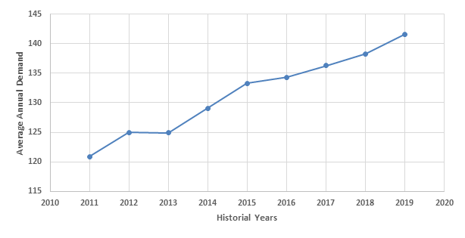
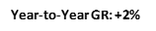
DATA PREPARATION
(Demand growth rate trend)
Years | 2011 | 2012 | 2013 | 2014 | 2015 | 2016 | 2017 | 2018 | 2019
Average Demand | 120.86 | 124.9 | 124.91 | 129.08 | 133.29 | 134.31 | 136.33 | 138.29 | 141.59
Growth rate (%) | - | 3.27 | -0.02 | 3.23 | 3.16 | 0.76 | 1.48 | 1.42 | 2.33
Figure 1: Average Annual Demand over time series
Notes:
We first performed a data growth analysis on the existing data, and observed a 2% growth rate year-to-year in the average annual demand. We assumed a similar growth rate for the forecasted years that follow.
Given the results of the demand analysis (section Demand Growth Analysis), we can see that the growth rate year to year resembles that of a linear trend. This will help us in determining which forecasting methods we should focus on.

Slide 7
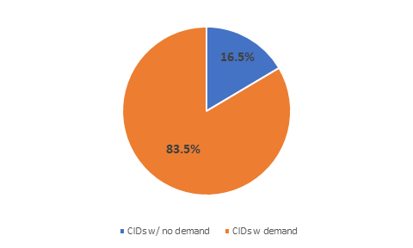
DATA PREPARATION
(Travel time analysis)
Figure 2: Ratio of tracts with 120-minute travel time satisfied for each hospital
Figure 3: CIDs with and without historical demand from 2011-2019
Hospital E and L with the most tracts that would exceed a 120-minute travel time.
Notes:
The above graphic shows the number of CIDs that would be assigned to the hospital, based on least travel time, should the hospitals be open and capable of conducting CT imaging. CT imaging capabilities are distributed across all hospitals. For example, there are 171 CIDs whose closest hospital is Hospital I. Of these tracts, we also determined how many of them were within 120 minutes of travel time, and how many were not, for each individual hospital. Hospital E and L seemed to be the hospitals with the highest number of tracts that would exceed a 120 minute travel time.
One of the assumptions that was made prior to conducting the analysis was that the CIDs with no demand in the historical years of data provided were demand satisfied. This would mean that when applying a forecasting methodology, these CIDs would possess no demand in the future years as well. By identifying these CIDs, we are reducing the dimensionality of the problem to allow for a more optimal solution to be achieved.

Slide 8
FORECASTING METHODS
Linear trend: linear regression and double moving average
Forecasting conclusion: stronger forecasting method was linear regression since it had the lowest mean absolute deviation (MAD) value.
Metrics | Double moving average (DMA) | Linear Regression
MAD | 8.73 | 2.84
MSE | 28023.59 | 927.84

Slide 9
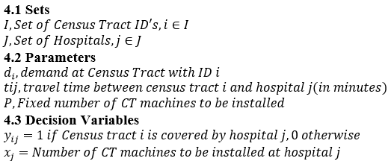
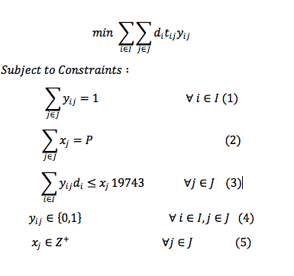
THE MODEL
(Objective function)
Notes:
The objective in this CT machine location problem was to maximize utilization so that up to 90% of population is within 120 minutes of CT location.
Objective function:
The objective function minimizes the demand weighted total travel time.
Constraint-1
This constraint stipulates that demand nodes (census tracts) can only be assigned to available CT machines at hospitals.
Constraint-2
This constraint states that each demand (census Tract) node must be assigned to exactly one facility (hospital).
Constraint-3
The third constraint states that we are to locate (install) exactly P number of CT machines.
Constraint-4
This constraint ensures that demand covered by each hospital should match the capacity at the hospital
Constraint-5
These are binary constraints.
Constraint-6
These are standard integrality constraints.
Model Implementation:
When we modelled the problem in Excel we tried using the standard Excel solver but it could not solve as the number of variables are more than 200 limit. So we decided to use an Open solver (CBC solver engine) for solving. The model is made available in the Excel solver to make it readable for the reader without any additional add-ins.
During the implementation we ran the model for different values of P= {8, 9, 10, 11,12,13,15,20}
i.e. (fixed number of CT machines). The model couldn’t find an optimal solution when P<=8 CT machines were installed. The model started to give optimal solutions from P=9 CT machines. Forevery value of P, we calculated the utilization with the optimal solution.

Slide 10
EXCEL DSS
Consolidate input data from demand and model
Provide users with front-end tool to support business decisions and provide justification on studied implementation
Provide summary statistics to give user ability to see impact of new CT installations
Input Variables
Number of CTs
CT Capacity
Demand Forecasting
Cost Variables
Evaluation Variables
Cost & Utilization Efficiency
Population Coverage
Demand Statistics
Notes:
The Excel DSS provides decision-makers with the ability to consolidate data across many input streams to provide insight into the system operations and needs. The DSS combines the analytics performed on the demand forecasting with the facility location modelling. The integration of these modules results in a front-end which allows the user to manipulate different critical variables and observe the impact that this has on the overall optimization of the problem.
The critical input variables are:
Number of CTs
CT max capacity
Demand forecasting approach
Cost variables (exam, new installation and annual operating)
The critical output variables that allow for decision making are:
Cost and Utilization efficiency
Population coverage (for travel times from 45mins to 120 mins)
Demand outputs

Slide 11
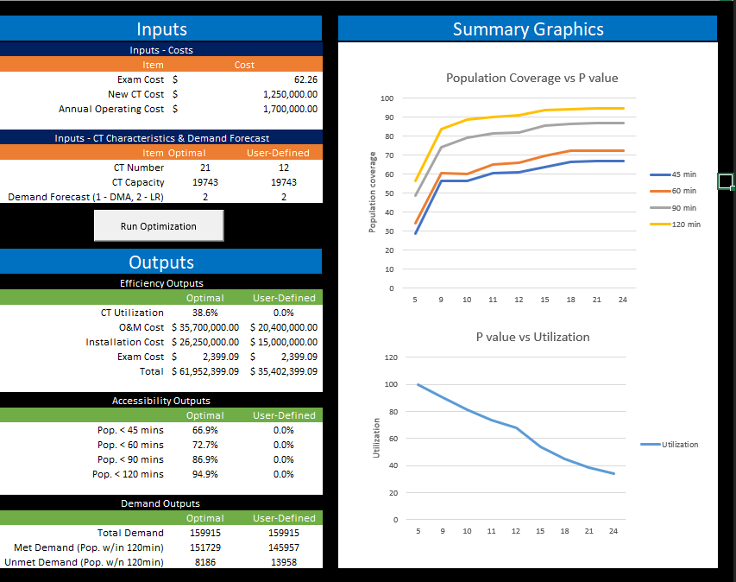
INPUTS
SUMMARY STATISTICS
OUTPUTS
Notes:
This is a snapshot of the front end user interface for the user

Slide 12
CASE STUDIES
Identify scenarios (based on CT number) to test and evaluate effectiveness based on the output metrics from the DSS
Make recommendations to Tolana province’s RHA about best implementation
Ensure case studies meet objectives and provide insight into system performance

Slide 13
CASE STUDIES
Identified and evaluated 5 case studies.
Case study 1: Installing 5 CTs within the region
Case study 2: Installing 9 CTs within the region
Case study 3: Obtaining 90% of the population within 120 mins of CT machine
Case study 4: Minimizing Overall Weighted Travel Time (Min. Obj. Function)
Case study 5: Installing 24 CTs within region.

Slide 14
RESULTS
Efficiency Outputs
 | User-Defined
CT Utilization | 73.6%
O&M Cost | $ 18,700,000.00
Installation Cost | $ 13,750,000.00
Exam Cost | $ 9,956,336.26
Total | $ 42,406,336.26
Accessibility Outputs
 | User-Defined
Pop. < 45 mins | 60.6%
Pop. < 60 mins | 65.4%
Pop. < 90 mins | 81.2%
Pop. < 120 mins | 90.3%
Demand Outputs
 | User-Defined
Total Demand | 159915.4556
Met Demand | 144545.4
Unmet Demand | 15370.05560
Efficiency Outputs
 | User-Defined
CT Utilization | 38.6%
O&M Cost | $ 35,700,000.00
Installation Cost | $ 26,250,000.00
Exam Cost | $ 9,956,336.26
Total | $ 71,906,336.26
Accessibility Outputs
 | User-Defined
Pop. < 45 mins | 66.9%
Pop. < 60 mins | 72.7%
Pop. < 90 mins | 86.9%
Pop. < 120 mins | 94.9%
Demand Outputs
 | User-Defined
Total Demand | 159915.4556
Met Demand | 151728.7
Unmet Demand | 8186.7556
Case Study 3: Obtaining 90% of the population within 120 mins of CT machine
Case Study 4: Minimizing Overall Weighted Travel Time (Minimize Obj. Function)
Notes:
This slide shows the DSS outputs for case study 3 and case study 4 – Both these case studies meet the goal outlined by the RHA with regards to having 90% of the population within 120 minutes of a hospital with CT capabilities but the difference between the two solutions is case 3 identifies a local minima while case 4 identifies the global minima. This means that case 4 minimizes the overall travel time for all individuals within the population while, case study 3 just seeks to satisfy the goal outlined by the RHA and nothing more. From a cost and demand perspective we can see the cost increase that we would need (roughly $29M) in order to achieve the global optimal solution and achieve a minima with the unmet demand.

Slide 15

RECOMMENDATIONS
Studied cases provide RHA with a means for identifying what factors they want to balance in overall CT number selection
Selection of study depends on RHA’s desired outcome:
Minimizing travel times for entire regional population – Case Study 4 – 21 CTs
Balancing accessibility with cost – Case study 3 – 11 CTs
Notes:
Having performed the various studies to evaluate different CT number implementations, when we are making recommendations to the RHA we need to understand the RHAs overall goal with the implementation. The studied cases provide the outputs given real life constraints but to put everything into perspective its important to include the dollar value that the RHA would have to incur to achieve a particular outcome
In the event that the RHA would want to minimize the travel time of the population regardless of the cost aspect to installing new CTs, then we recommend that the RHA go with the case study 4 outcome which uses 21 CTs to achieve the goal of 90% of the population within 120 minutes in addition to achieving the global minimum.
If the RHA would want to balance the accessibility with some economic consideration of including a certain number of CTs, then we recommend the RHA go with case study 3, which still satisfies the goal of having 90% of the population within 120 minutes, but doesn’t converge to a global minima in the objective function thereby allow us to reduce the number of CTs and the cost of the particular implementation.
Questions?

Slide 16
Questions?

Slide 17
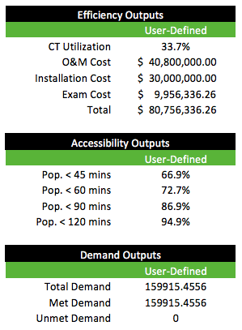
APPENDIX
Case Study 5: Installing 24 CTs within region.

